Slide 1

Climate, Energy, and the Southeast
An EPA Perspective
Presentation for Dr. Kim Cobb
Georgia Institute of Technology
February 20, 2013
Dr. Ken Mitchell and Bryan Myers
U.S. Environmental Protection Agency
Atlanta, GA

Slide 2
Topics to Cover
EPA’s efforts on
climate change mitigation
and adaptation
Discussion

Slide 3
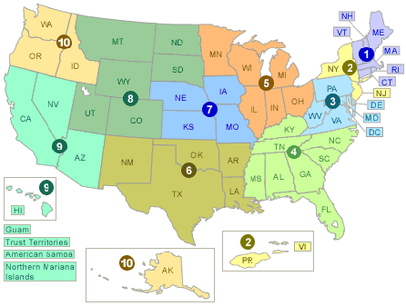
EPA has 10 Regional Offices

Slide 4
Potential Climate Change Impacts for the SE
Food production and agriculture
Water resources
Sea level rise and coastal areas
Health
  Climate sensitive diseases
  Air quality (ozone, aeroallergins)
  Weather-related illness/death
  (e.g., heat waves, storms)
Wildfires
Forestry resources
Energy, infrastructure,
and settlements
Ecosystems and wildlife
Climate Changes
Temperature Sea Level Rise
Precipitation

Slide 5
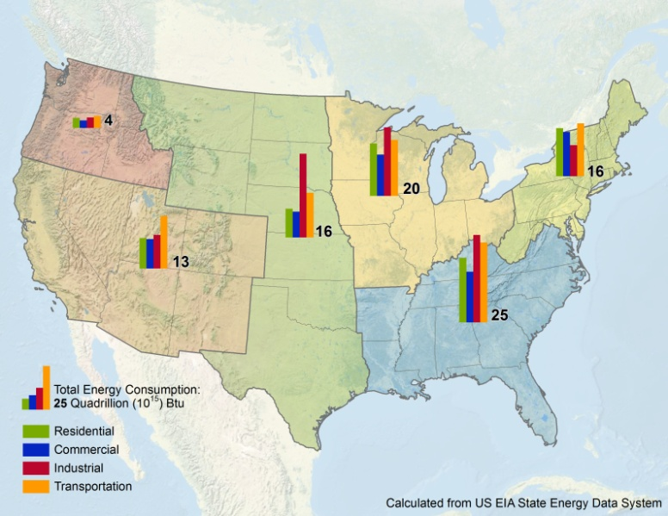
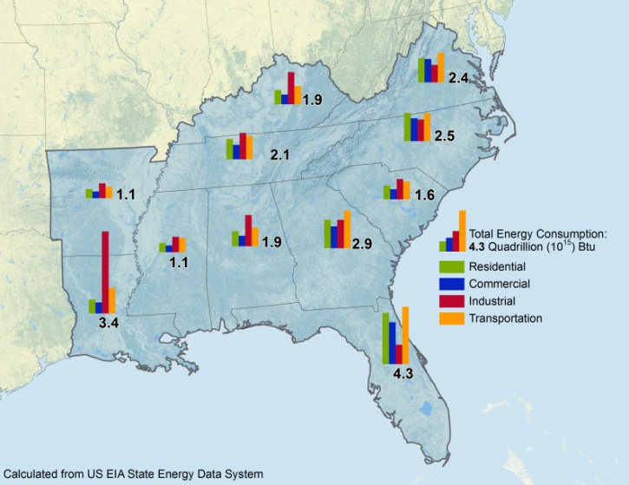
Energy Consumption in the Southeast
National Climate Assessment (NCA) Regions
Energy Consumption by NCA Region (2009)
Source: Energy Information Administration
Energy Consumption by Southeastern State (2009)

Slide 6
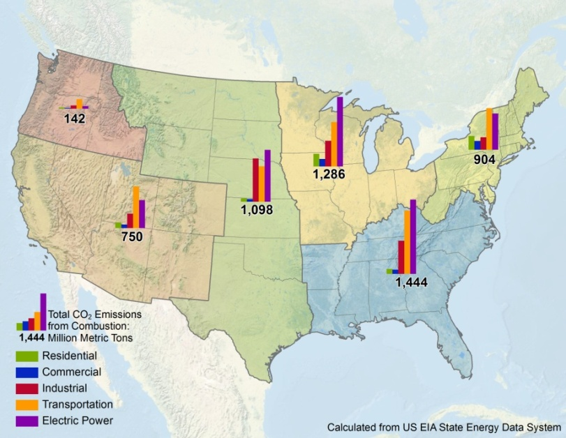
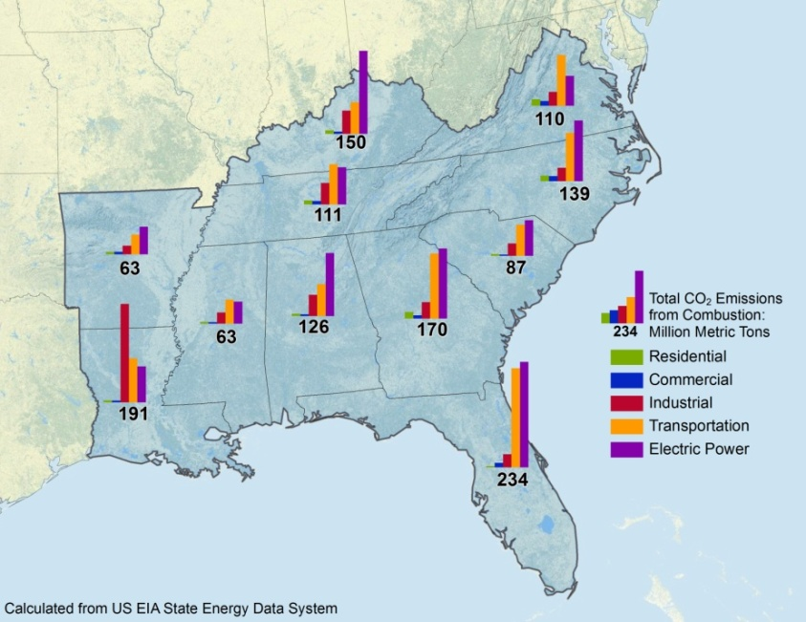
Combustion GHG Emissions in the Southeast
National Climate Assessment (NCA) Regions
Total CO₂ Emissions from Combustion
by Sector by NCA Region (2009)
Source: Energy Information Administration
Total CO₂ Emissions from Combustion
by Sector by Southeastern NCA State (2009)

Slide 7
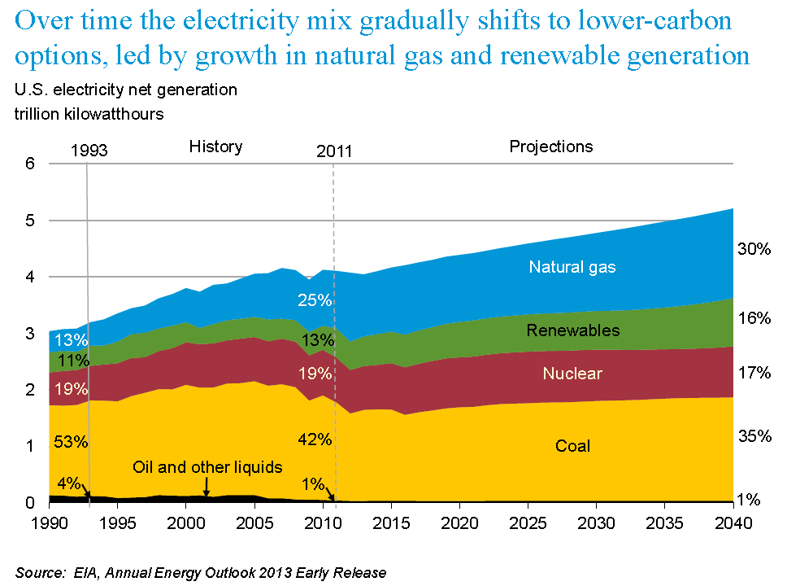
US Energy Mix
: http://www.eia.gov/pressroom/presentations/sieminski_12052012.pdf

Slide 8
Air Emissions from Traditional Energy Technologies
Technology | Carbon Dioxide (lbs/MWh) | Sulfur Dioxide (lbs/MWh) | Nitrogen Oxides (lbs/MWh)
Natural Gas | 1135 | 0.1 | 1.7
Coal | 2249 | 13 | 6
Oil | 1672 | 12 | 4
Nuclear Energy(1) | NA | NA | NA
Municipal Solid Waste | 2988 | 0.80 | 5.4
Hydroelectricity (2) | NA | NA | NA
Nuclear power plants do not emit carbon dioxide, sulfur dioxide, or nitrogen oxides. However, fossil fuel emissions are associated with the uranium mining and uranium enrichment process as well as the transport of the uranium fuel to the nuclear plant
Hydropower's air emissions are negligible because no fuels are burned. However, if a large amount of vegetation is growing along the riverbed when a dam is built, it can decay in the lake that is created, causing the buildup and release of methane, a potent greenhouse gas.
Source: http://www.epa.gov/cleanenergy/energy-and-you/affect/air-emissions.html#footnotes

Slide 9
Responses to Climate Change – Generally Speaking
Sustainability
Mitigation
(efforts to reduce GHG
emissions and atmospheric
GHG concentrations)
Both
(leverage efforts that
both reduce GHGs
and build resiliency)
Adaptation
(efforts to build resiliency to climate change impacts)
Example Activities
VMT Reduction
Energy Efficiency
Renewable Energy
Carbon Sequestration
Examples Activities
Green Roofs
LEED Buildings
Urban Forests
Example Activities
Water management Plans
Heat wave shelters
Resilient roads/bridges
Plans for migration
R e s e a r c h
Adapted from J. Penney, 2008, “Emerging Climate Change Adaptation Strategies,” Clean Air Partnership

Slide 10

EPA Activities That Affect Energy
EPA Priorities
  Improving air quality, protecting America’s waters, and taking action on climate change are top priorities for Administrator Jackson
  Values: transparency, sound science, rule of law
Some Key actions
  Regulatory
    Endangerment Finding
    Tailoring Rule
    NSPS for new electricity
    generation facilities
    PM and Ozone Standards
    Regional Haze
    Mobile Source Emission and
    CAFE Standards
    Renewable Fuels Standard
    Carbon Capture & Sequestration
    GHG Emissions Reporting
  Other Efforts
    Energy Efficiency
    Renewable Energy
    Voluntary Initiatives

Slide 11

EPA’s Endangerment Finding
Endangerment Finding:
Current and projected concentrations of the six key well-mixed GHGs in the atmosphere threaten the public health and welfare of current and future generations.
Cause or Contribute Finding:
The combined emissions of these well-mixed GHGs from new motor vehicles and new motor vehicle engines contribute to the greenhouse gas pollution which threatens public health and welfare.
Final Rule published in Federal Register December 15, 2009
Greenhouse Gases (GHGs)
Carbon Dioxide (CO₂)
Methane (CH₄)
Nitrous Oxide (N₂O)
Hydrofluorocarbons (HFC)
Perfluorocarbons (PFC)
Sulfur Hexafluoride (SF₆)

Slide 12
GHG Reporting Program
Purpose is to collect accurate and timely GHG data to inform future policy decisions
EPA issued Mandatory Reporting of Greenhouse Gases Rule
(74 FR 5620)
  Requires reporting of GHG
  emission data from specific
  entities in the U.S.
    GHG suppliers
    Direct emitting source categories
    Facilities that inject CO₂ underground
For 2011 emissions, reports
were due to EPA March 31, 2012
Highlights for 2011
(Data released 2/5/13)
Power plants are the largest stationary source emitter at 2,221 MMT CO2e (about 1/3 of total U.S. emissions)
Petroleum and natural gas systems were the second largest sector, with emissions of 225 mmtCO2e in 2011, the first year of reporting for this group
Refineries were the third-largest emitting source, with 182 mmtCO2e, a half of a percent increase over 2010.
http://www.epa.gov/ghgreporting/

Slide 13
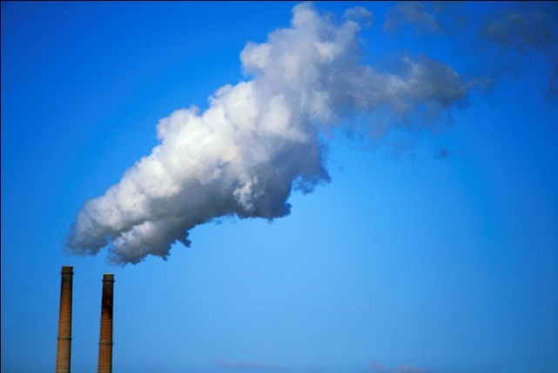
The Tailoring Rule
Final Rule issued May 13, 2010
Establishes thresholds for GHG emissions and
defines when permits under the New Source Review
Prevention of Significant Deterioration (PSD)
and Title V Operating Permit programs are
required for new and existing industrial facilities
“Tailors" the requirements to limit which facilities
will be required to obtain PSD and Title V permits
Includes the nation's largest GHG emitters -- power plants, refineries, and cement production facilities
http://www.epa.gov/nsr/ghgpermitting.html

Slide 14
GHG NSPS for New Fossil Fuel-Fired Power Plants
On March 27, 2012, EPA proposed the first Clean Air Act standard for carbon pollution from new fossil-fuel-fired EGUs
  Includes fossil‐fuel‐fired boilers, integrated gasification combined cycle (IGCC) units and stationary combined cycle turbine units that generate electricity for sale and are larger than 25 megawatts (MW)
  An output‐based standard of 1,000 pounds of CO2 per megawatt‐hour
  (lb CO2/MWh gross)
New natural gas combined cycle (NGCC) power plant units should be able to meet the proposed standard without add-on controls
New power plants that are designed to use coal or petroleum coke would be able to incorporate technology to reduce CO2 emissions to meet the standard, such as carbon capture and storage (CCS)
  New power plants that use CCS would have the option to use a 30‐year average of CO2 emissions to meet the proposed standard, rather than meeting the annual standard each year
http://www.epa.gov/carbonpollutionstandard/index.html

Slide 15
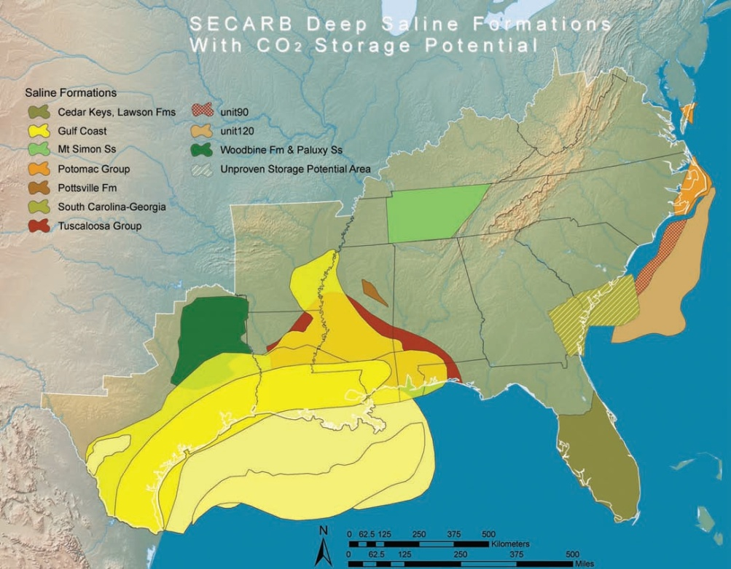
Geologic Sequestration of CO₂
In December 2010, EPA published final rules for CO₂ Geologic Sequestration (GS) Wells
Establishes requirements for long-term underground storage, or geologic sequestration, and a new well class – Class VI – to ensure the protection of underground sources of drinking water (USDWs) from injection related activities
http://www.netl.doe.gov/technologies/carbon_seq/refshelf/atlasII/ and
http://water.epa.gov/type/groundwater/uic/class6/gsregulations.cfm

Slide 16
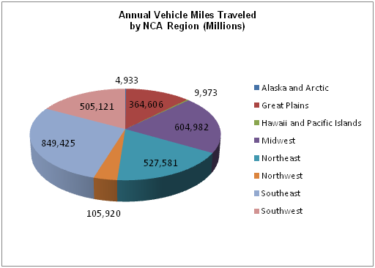
We travel a lot!
Source: Federal Highway Administration - 2009 Highway Statistics Series (SE values includes Puerto Rico)

Slide 17
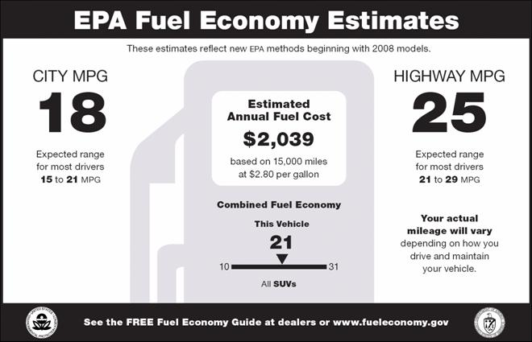
Mobile Source GHG/CAFE Standards
Final rule (published 5/7/10) - Passenger cars, light-duty trucks, and medium-duty passenger vehicles, model years 2012 through 2016
  Average 250 grams CO₂ per mile, 35.5 mpg in model year 2016
Final rule (published 9/15/11) - Medium- and heavy-duty engines and vehicles, model years 2014 through 2018
  Estimated combined standards will reduce CO₂ emissions by about 270 million metric tons and save about 530 million barrels of oil over the life of vehicles built for the 2014 to 2018 model years, providing $49 billion in net program benefits
Final rule (issued 8/28/2012) –
Extends passenger vehicle program
to model year 2017 through 2025
  Average163 grams CO₂ per mile,
  54.5 mpg in model year 2025
http://epa.gov/otaq/climate/regulations.htm#1-1

Slide 18
Renewable Fuels Standard (RFS2)
Lifecycle GHG Thresholds Specified in EISA
(percent reduction from 2005 baseline for gasoline and diesel)
Renewable fuel* | 20%
Advanced biofuel | 50%
Biomass-based diesel | 50%
Cellulosic biofuel | 60%
Revision to current RFS (RFS1)
as required by the Energy
Independence and Security Act
(EISA)
Significant increase in renewable fuels
to displace petroleum consumption
(36 billion gallons by 2022)
Requires GHG lifecycle analysis
Original Rule published 3/26/10
On 11/16/12, EPA denied the requests for the waiver of the renewable fuel standard
On 1/31/13, EPA published the proposal to establish the annual percentage standards for fuels that apply to all gasoline and diesel produced or imported in year 2013 under the RFS Program
*The 20% criterion generally applies to renewable fuel from new facilities that commenced construction after December 19, 2007.
http://www.epa.gov/otaq/fuels/renewablefuels/index.htm

Slide 19
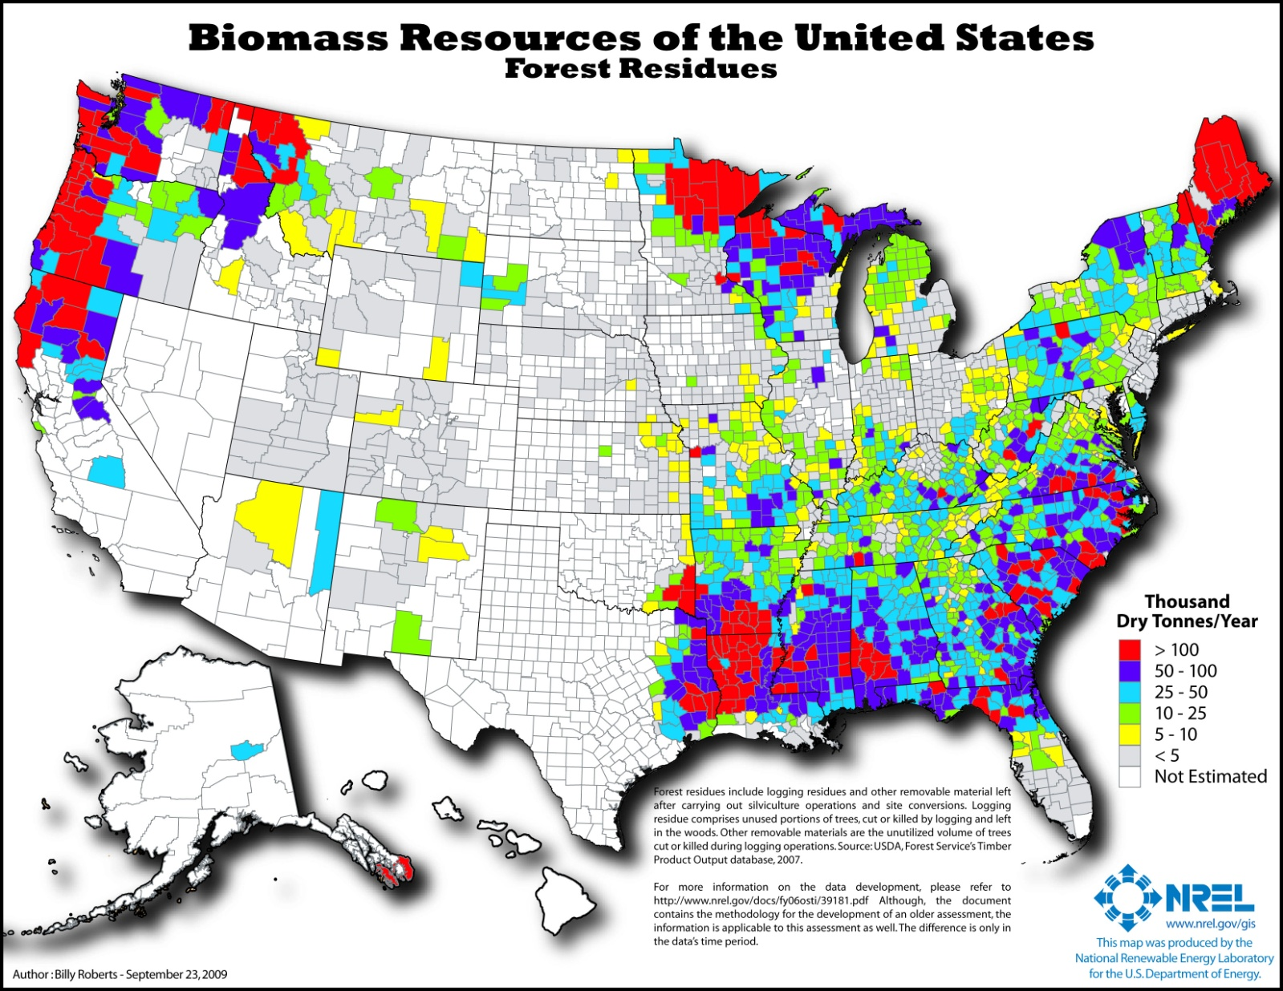
SE - Significant Biomass Resources

Slide 20
D.C. Circuit – Climate Change Litigation
Coalition for Responsible Regulation Inc. v. EPA -- On June 26, 2012, the U.S. Court of Appeals for the D.C. Circuit upheld EPA's Endangerment Finding and greenhouse gas regulations issued under the Clean Air Act (CAA) for passenger vehicles and CAA permitting for stationary sources.
Today's ruling is a strong validation of, in the Court's own words, the "unambiguously correct" approach we have taken in responding to the 2007 Supreme Court decision. I am pleased that the U.S. Court of Appeals for the D.C. Circuit found that EPA followed both the science and the law in taking common-sense, reasonable actions to address the very real threat of climate change by limiting greenhouse gas pollution from the largest sources.
Lisa Jackson
EPA Administrator
http://www.epa.gov/climatechange/endangerment/ghgcourtdecision.html

Slide 21
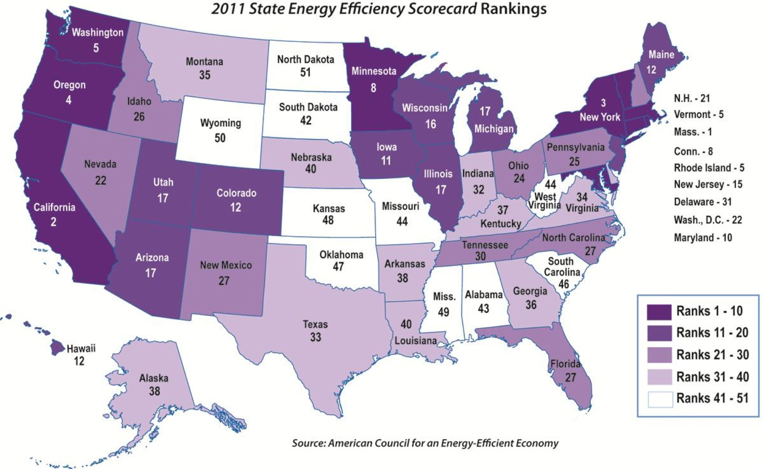
SE Lags in Energy Efficiency

Slide 22
What about Energy Efficiency?
A recent study by Duke University and GA Tech showed aggressive EE initiatives in the South could, by 2020:
  Prevent 16% growth in energy consumption in the residential, commercial, industrial (RCI) sectors
  Retire almost 25 GW of older power plants and avoid 49 GW from new plants
  Generate jobs and cut utility bills
    Energy bills reduced by $41 billion
    Electricity rate increases moderated
    380,000 new jobs created
    Grow Region’s economy by $1.23 billion
  Result in significant water savings
    8.6 billion gallons freshwater conserved in 2020 (56% of projected growth in cooling
    water needs)
    20.1 billion gallons conserved water by
    2030 (or 45% of projected growth)
Source - Southeast Energy Efficiency Study: Energy Efficiency in the South

Slide 23







What about Renewable Energy?
Renewable energy technologies are key to creating a clean energy future for not only the nation, but the world
  Constantly replenished and will not run out
  Our nation has abundant renewable energy resources
  Can have a smaller environmental impact than traditional
  (e.g., fossil fuel) sources
See: http://www.nrel.gov/learning/

Slide 24
EPA Programs Supporting Renewable Energy
State and Local Climate and Energy Program
  The State Climate and Energy Program helps states develop policies and programs that can reduce greenhouse gas emissions, lower energy costs, improve air quality and public health, and help achieve economic development goals. EPA provides states with and advises them on proven, cost–effective best practices, peer exchange opportunities, and analytical tools.
Green Power Partnership (GPP)
  GPP is a voluntary program that supports the organizational procurement of green power by offering expert advice, technical support, tools, and resources. The Partnership works with thousands of companies, colleges and universities, organizations, and local, state, and federal government agencies. GPP provides resources to states on how they can lead by example by purchasing green power for government operations.
Landfill Methane Outreach Program (LMOP)
  LMOP is a voluntary assistance and partnership program that promotes the use of landfill gas as a renewable, green energy source. By preventing emissions of methane through the development of landfill gas energy projects, LMOP helps businesses, states, energy providers, and communities protect the environment and build a sustainable future.
AgSTAR
  AgSTAR is a voluntary program jointly sponsored by EPA, the U.S. Department of Agriculture, and the U.S. Department of Energy. The program encourages the use of methane recovery (biogas) technologies at confined animal feeding operations that manage manure as liquids or slurries.
RE–Powering America's Lands
  EPA is encouraging renewable energy development on current and formerly contaminated land and mining sites. This initiative identifies the renewable energy potential of these sites and provides other useful resources for communities, developers, industry, state and local governments or anyone interested in reusing these sites for renewable energy development.

Slide 25
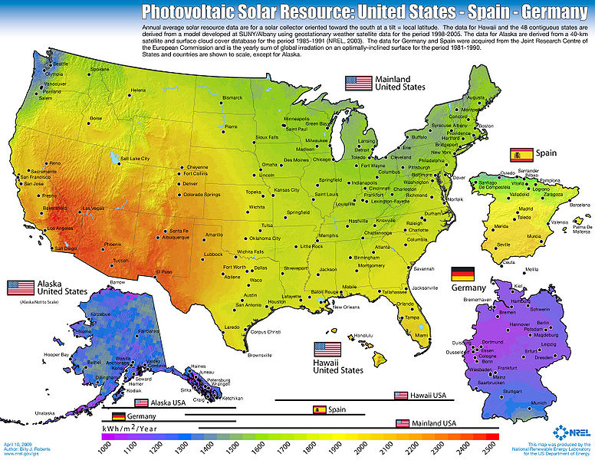
Georgia’s Solar Resource

Slide 26





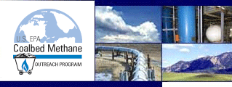











Partnership Programs to Address Energy/Climate

Slide 27
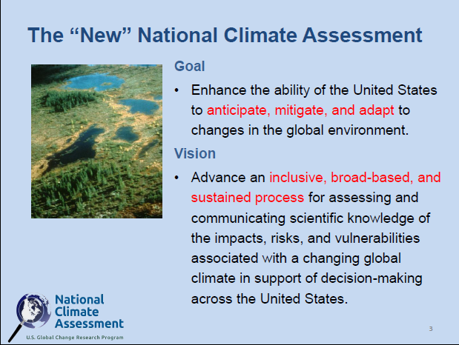
http://www.globalchange.gov/what-we-do/assessment

Slide 28
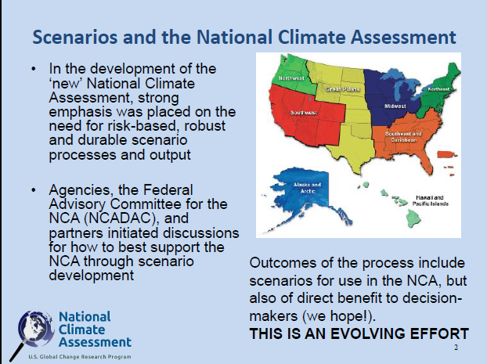

Slide 29
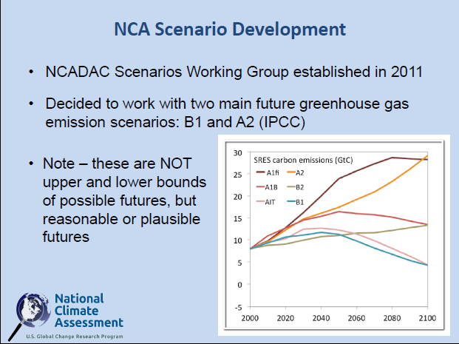
http://scenarios.globalchange.gov/

Slide 30
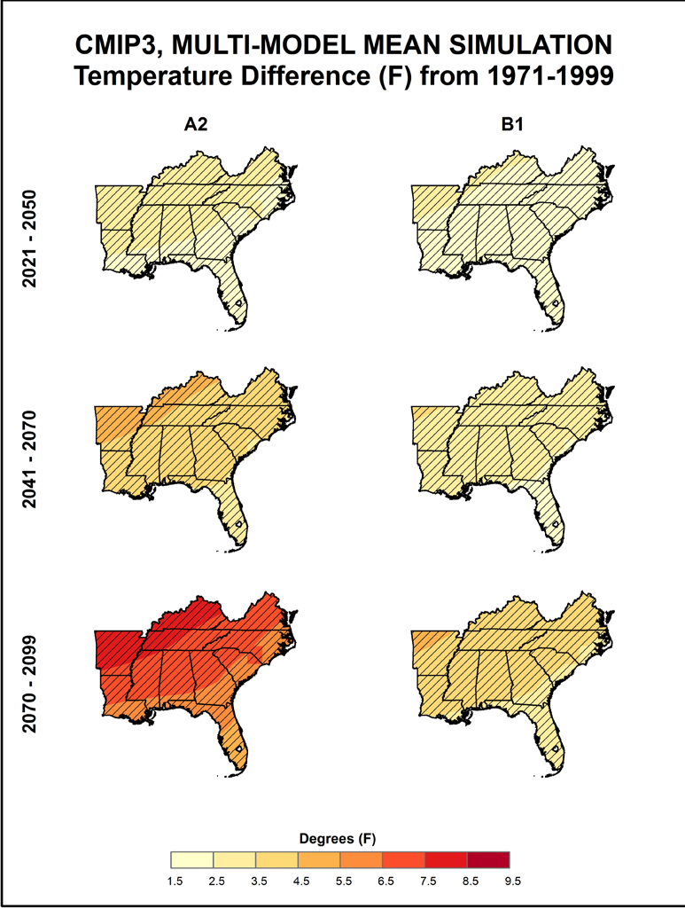
Temperature

Slide 31
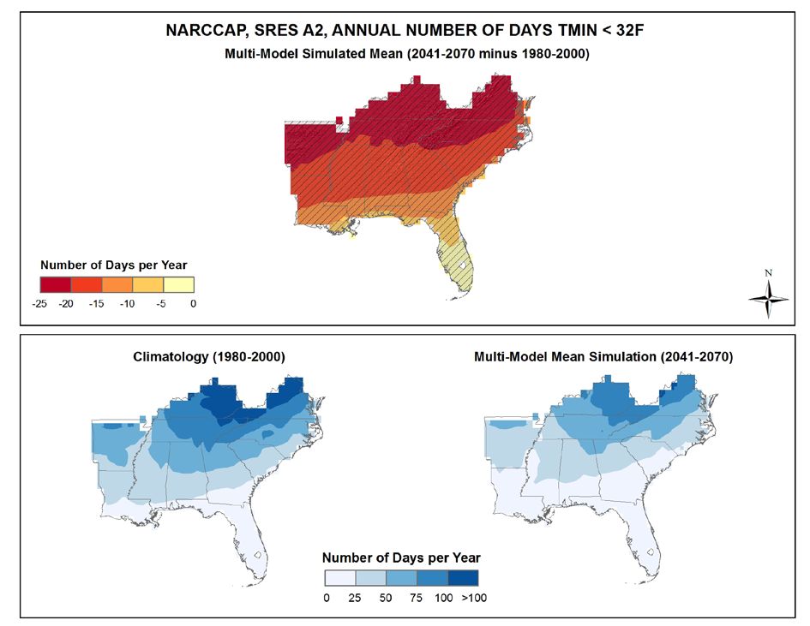
Temperature

Slide 32
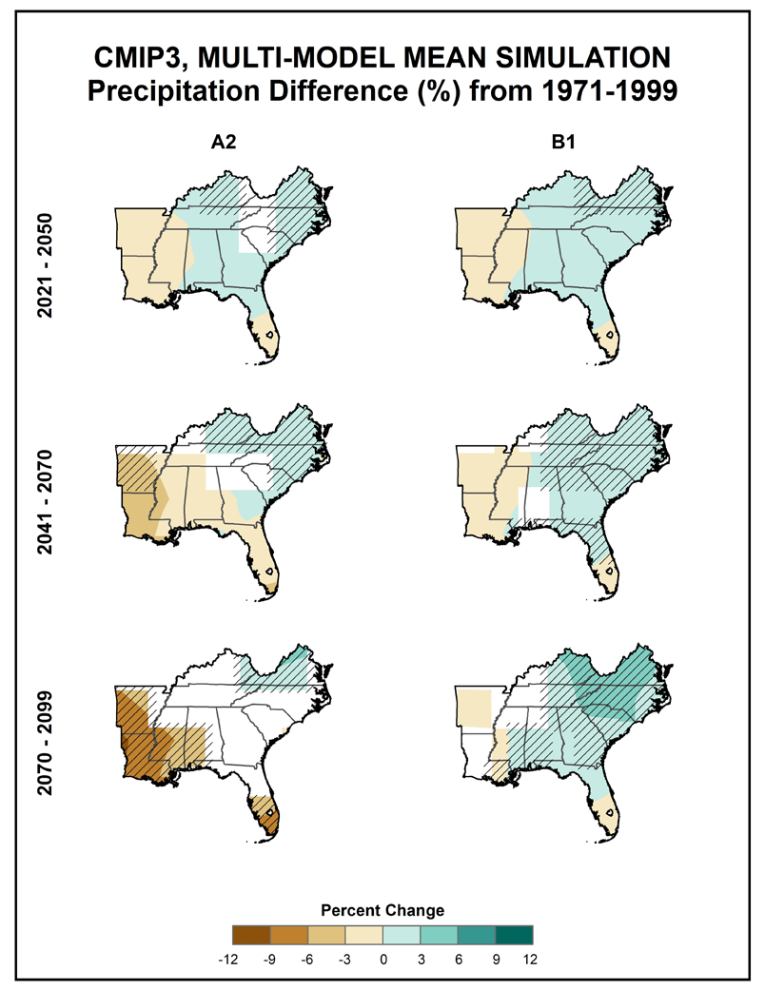
Precipitation

Slide 33
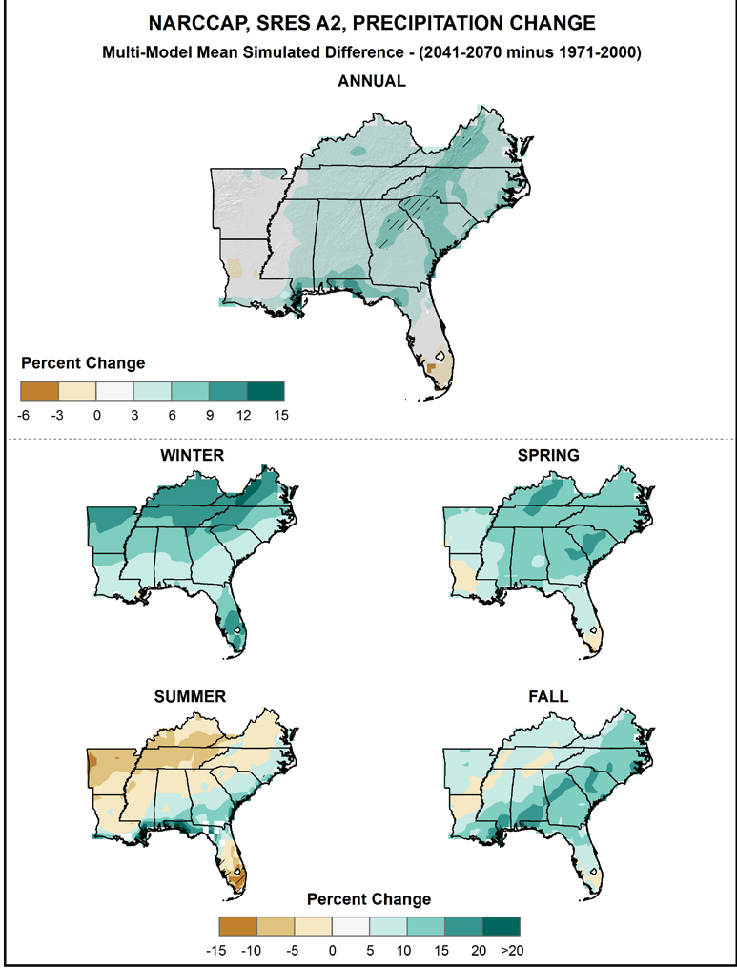
Precipitation

Slide 34
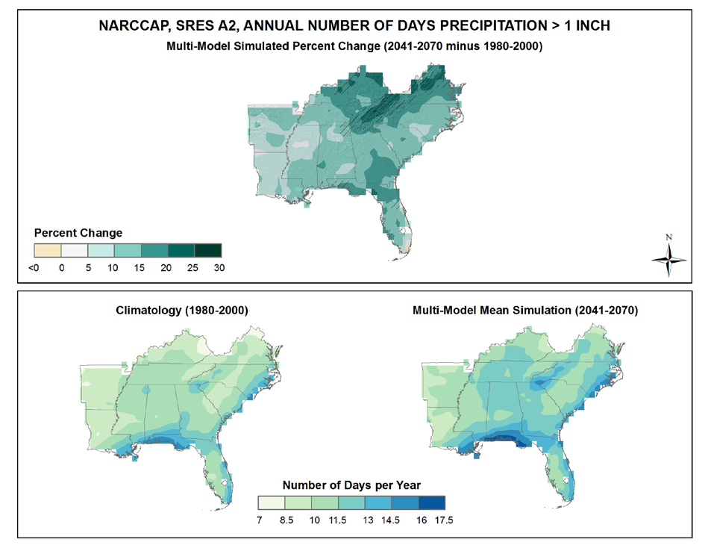
Precipitation

Slide 35
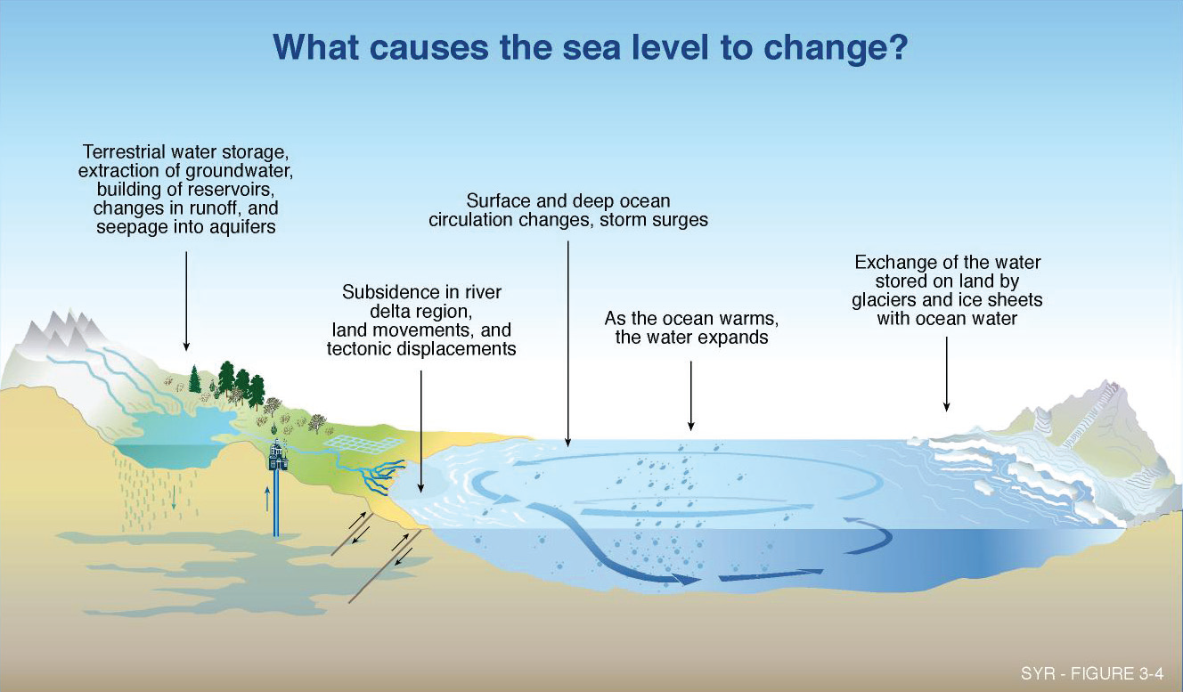
Sea Level Rise

Slide 36
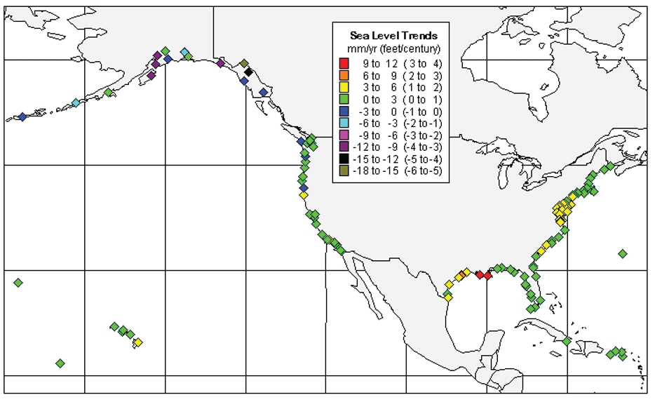
Sea Level Rise
Figure 3. Relative Sea Level (RSL) Variations of the United States (1854 to 2006). Derived from 128 National WaterLevel Observation Network Stations.

Slide 37
EPA’s Road to Adaptation
On October 5, 2009, President Obama signed an Executive Order directing the Interagency Climate Change Task Force to develop a report with recommendations for how the Federal Government can strengthen policies and programs to better prepare the Nation to adapt to the impacts of climate change.
On March 4, 2011, CEQ issued a set of Implementing Instructions for Federal Agency Adaptation Planning. The Instructions informed agencies on how to integrate climate change adaptation into their planning, operations, policies, and programs.
In June of 2011 the EPA Administrator issued a policy statement on climate change adaptation. In response, EPA will complete a Climate Change Adaptation Plan in 2012. Subsequently, every program and regional office within the EPA will develop an Implementation Plan outlining how each considers the impacts of climate change in its mission, operations, and programs, and carry out the work called for in the agency-wide plan.
In February 2013 EPA released its Draft Climate Change Adaptation for public comment.
http://www.whitehouse.gov/administration/eop/ceq/initiatives/adaptation

Slide 38
EPA Encourages Adaptation
Clean Energy-Environment State Partnership. A voluntary state-federal partnership that encourages states to develop and implement cost-effective clean energy and environmental strategies.
Climate Ready Water Utilities. Provides resources for the water sector to adapt to climate change by promoting a clear understanding of climate science and adaptation options and by promoting consideration of integrated water resources management planning in the water sector.
Climate Ready Estuaries. Works with the National Estuary programs to help coastal managers assess climate change vulnerabilities, implement adaptation strategies, educate stakeholders, and share lessons learned.
Sustainable Communities. The Sustainable Communities Partnership, involving the Department of Energy, the Department of Transportation, and EPA, works to create communities that have a variety of housing and transportation choices, with destinations close to home, in order to lower transportation costs, reduce air pollution and stormwater runoff, and provide many other benefits.
http://www.epa.gov/climatechange/impacts-adaptation/fed-programs.html

Slide 39


Questions?
Ken Mitchell
mitchell.ken@epa.gov
Bryan Myers
myers.bryan@epa.gov
www.epa.gov

